Slide 1
INTRODUCTION TO
ALGORITHMS
FOURTH EDITION

Slide 2
LECTURE NOTES FOR CHAPTER 32
String Matching

Slide 3
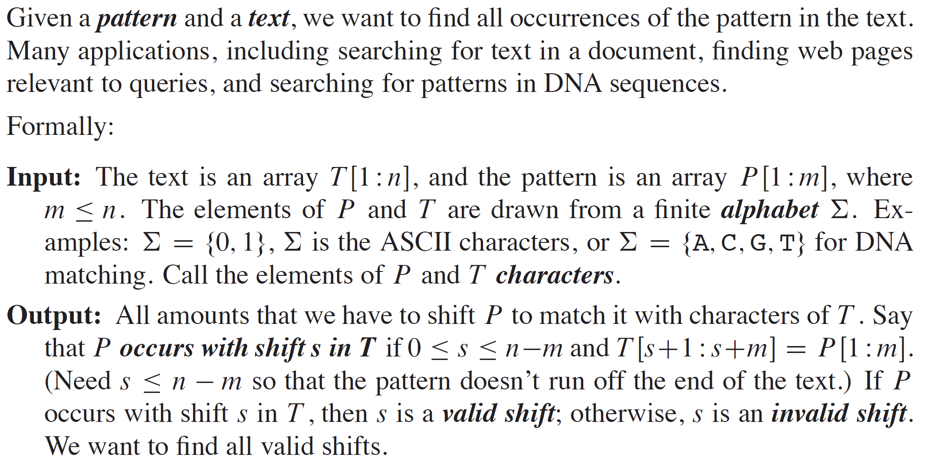
CHAPTER 32 OVERVIEW

Slide 4
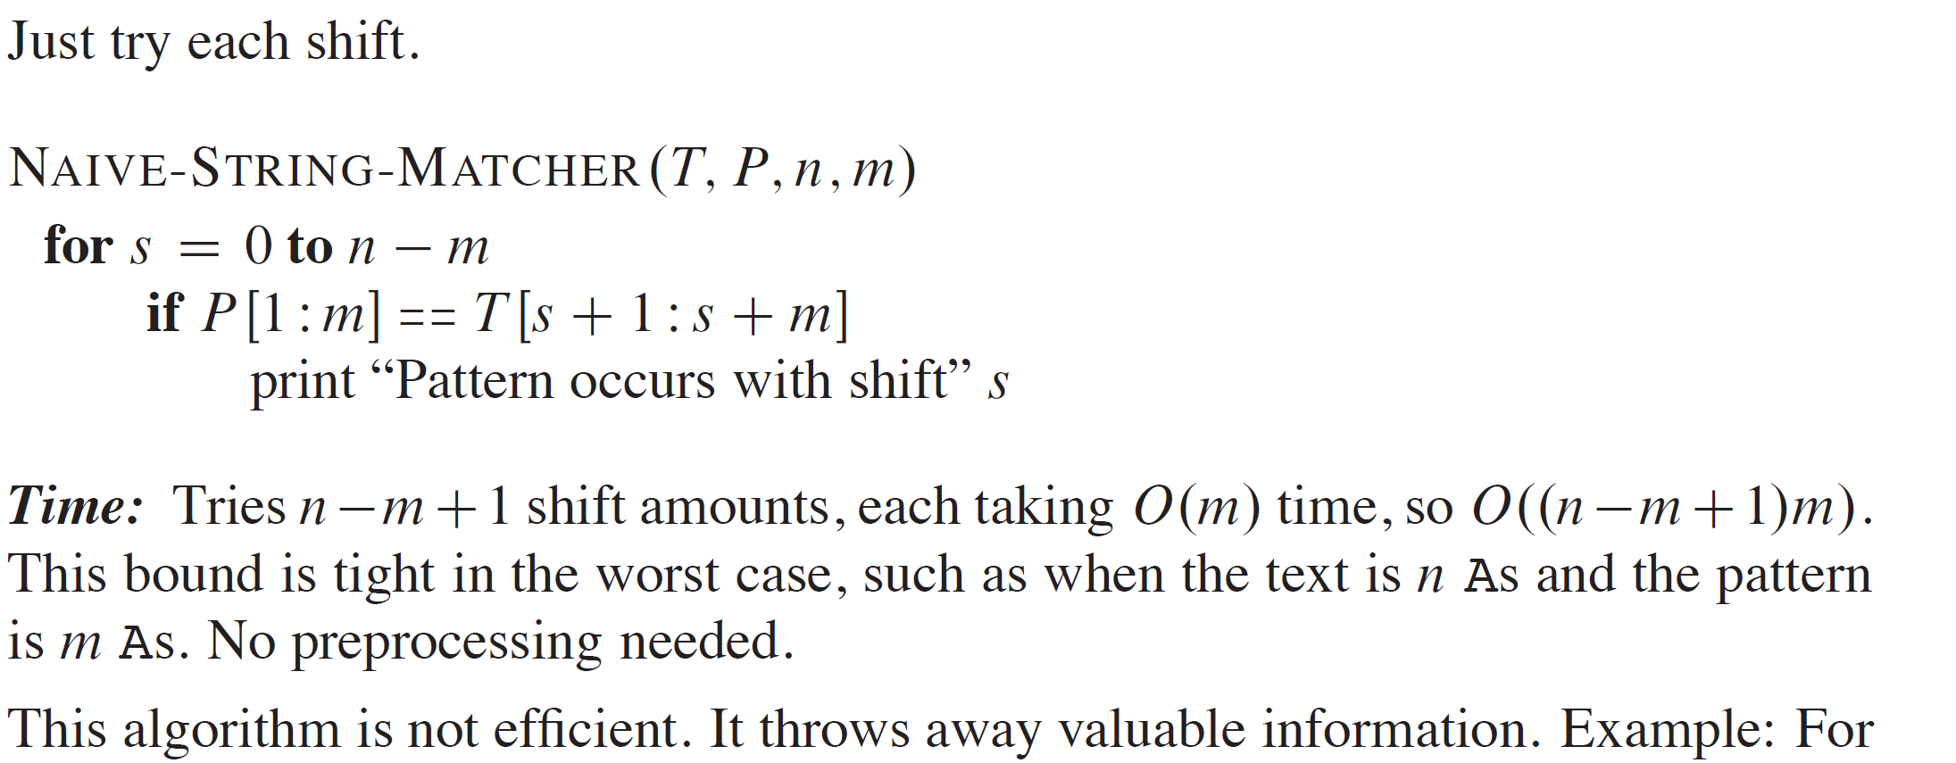
NAIVE STRING-MATCHING ALGORITHM

Slide 5
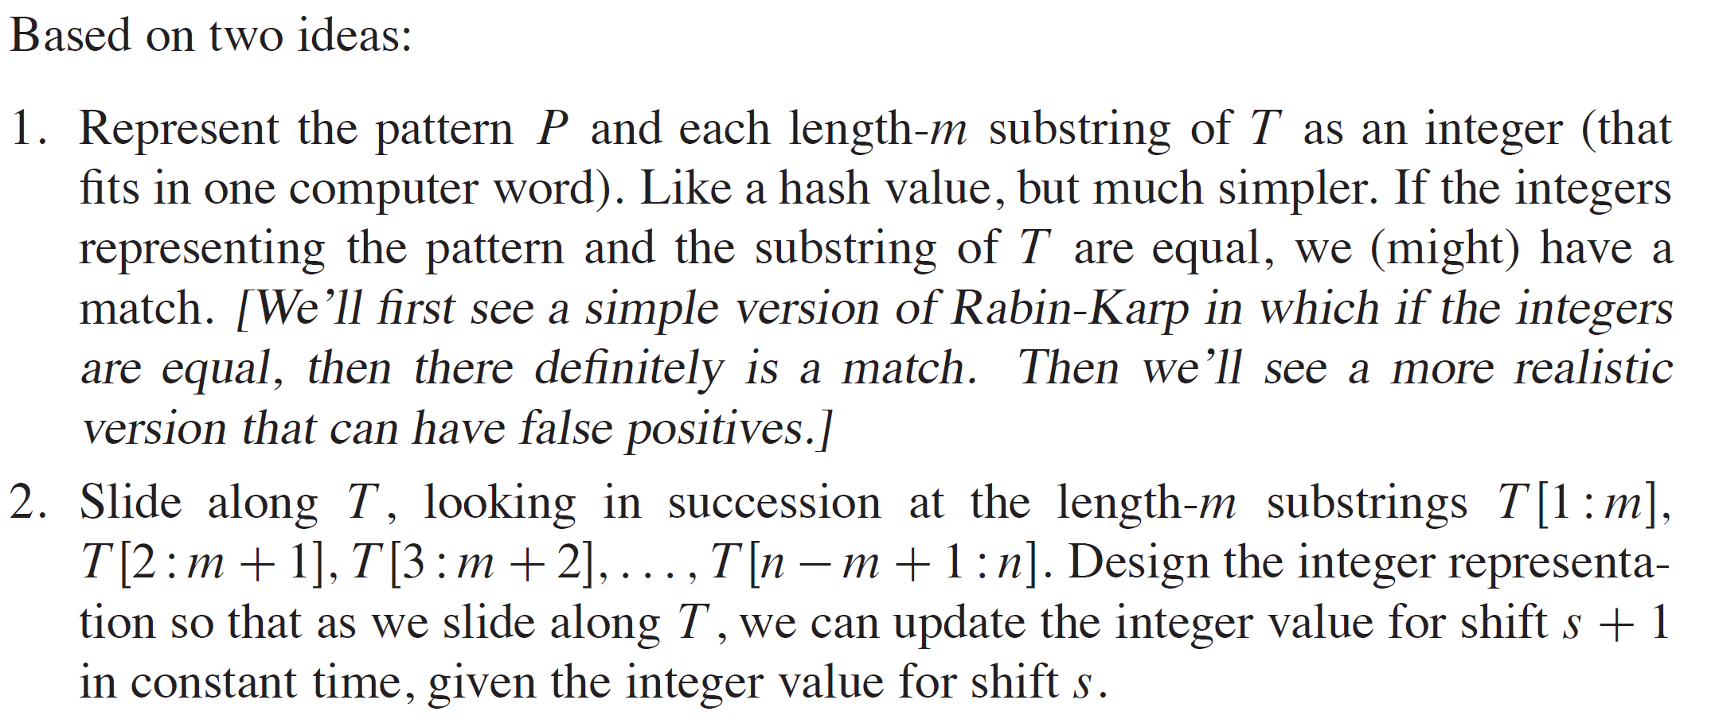
RABIN-KARP ALGORITHM

Slide 6
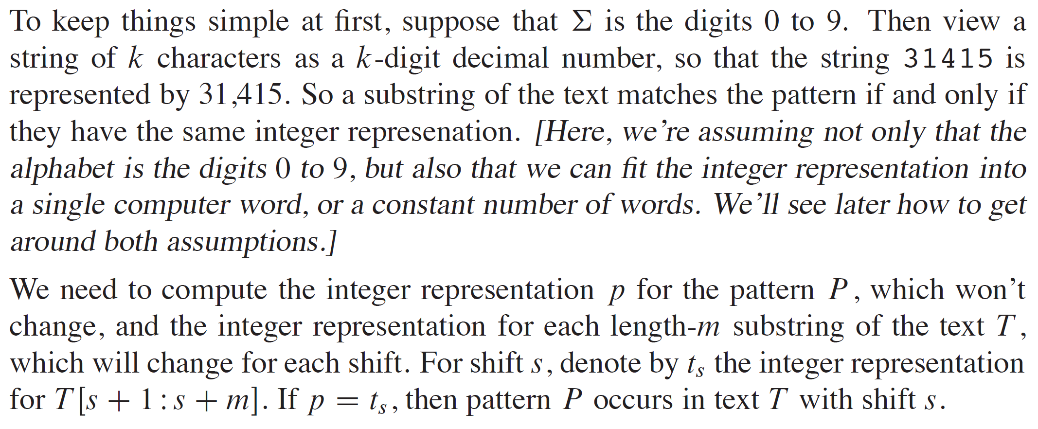
RABIN-KARP ALGORITHM (continued)

Slide 7
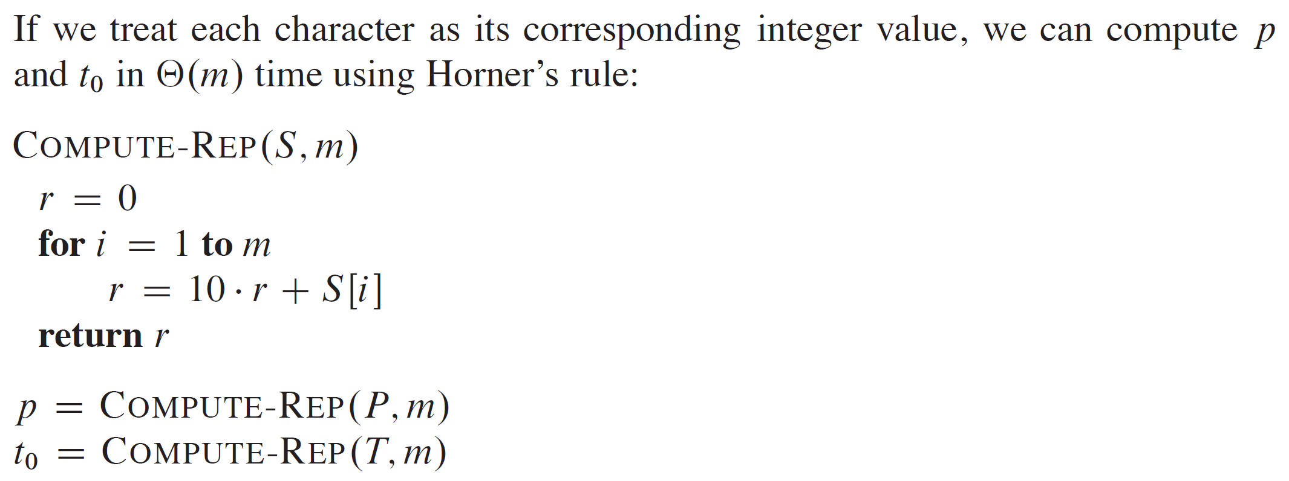
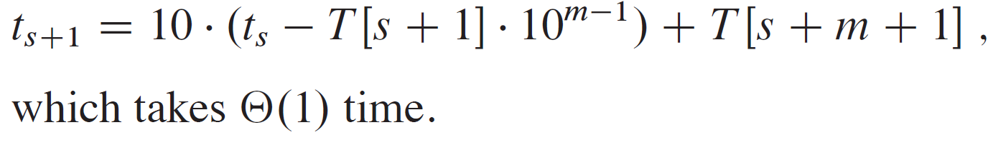
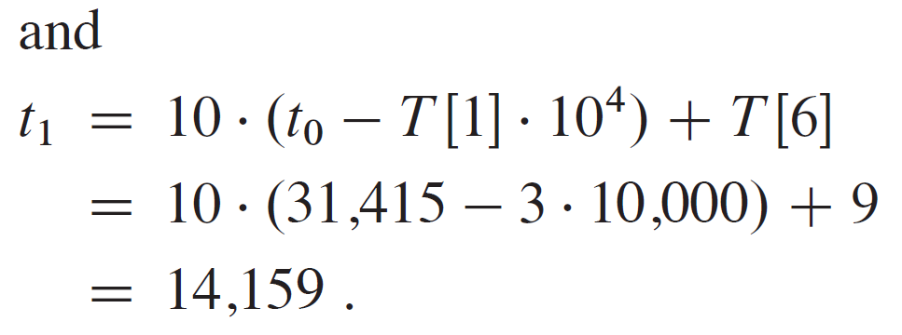
RABIN-KARP ALGORITHM (continued)

Slide 8
RABIN-KARP ALGORITHM (continued)

Slide 9
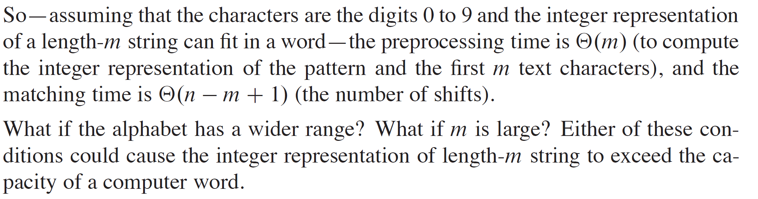
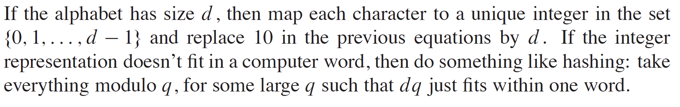
RABIN-KARP ALGORITHM (continued)

Slide 10
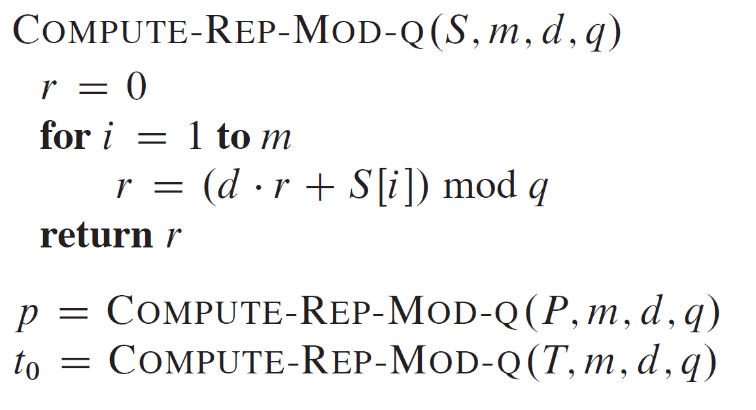
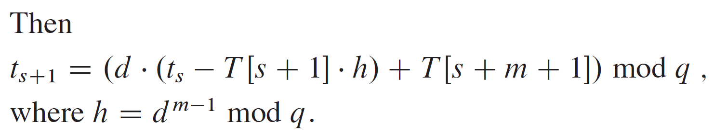
PSEUDOCODE

Slide 11
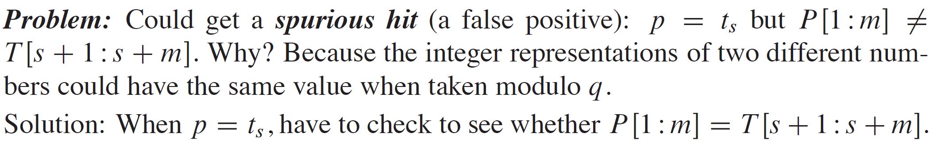
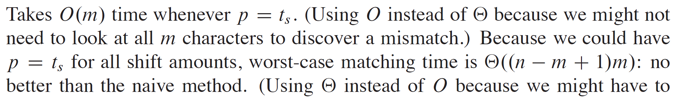
RABIN-KARP ALGORITHM (continued)

Slide 12
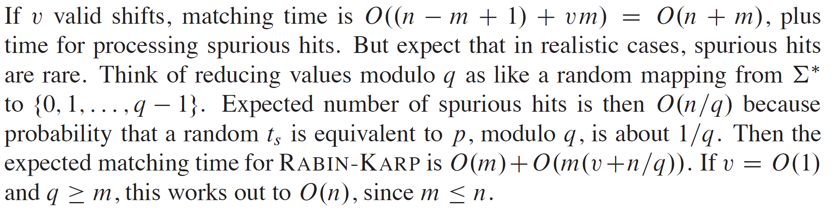
RABIN-KARP ALGORITHM (continued)

Slide 13
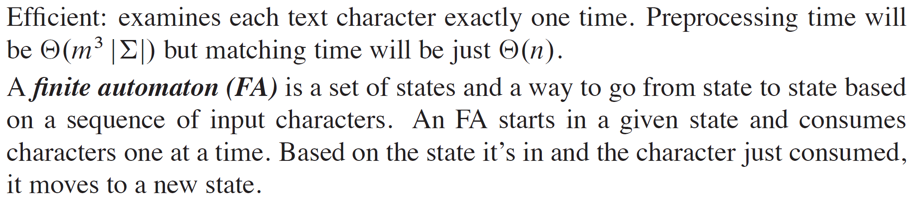
STRING MATCHING WITH FINITE AUTOMATA

Slide 14
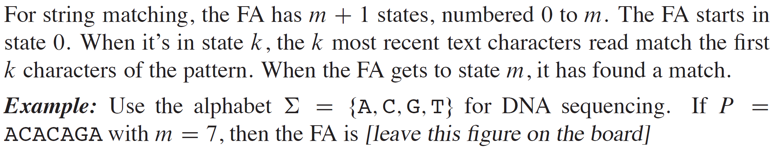
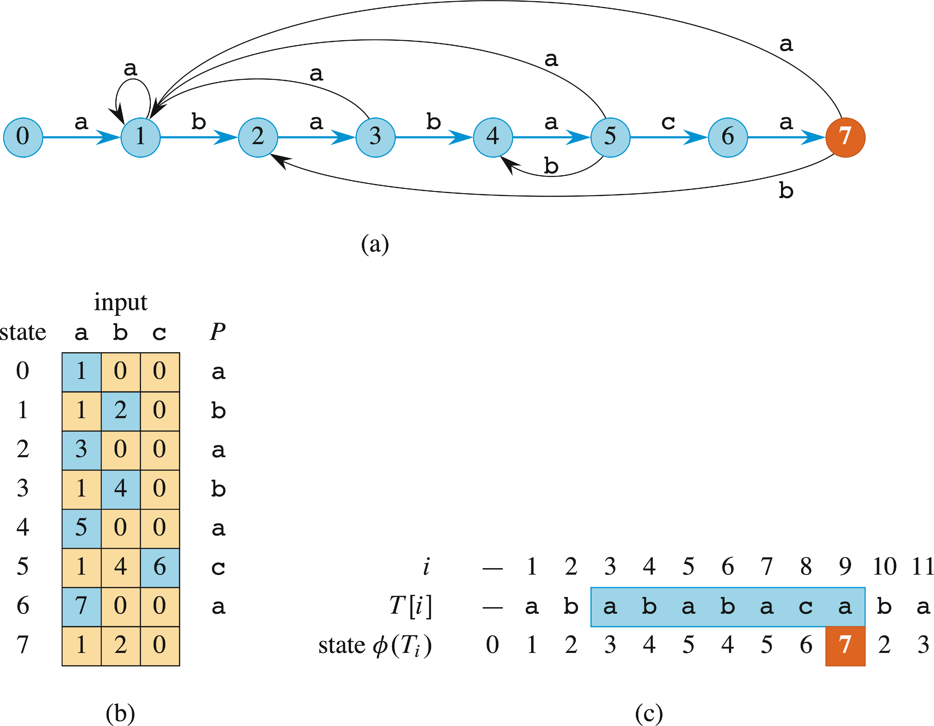
STRING MATCHING WITH FINITE AUTOMATA (continued)

Slide 15
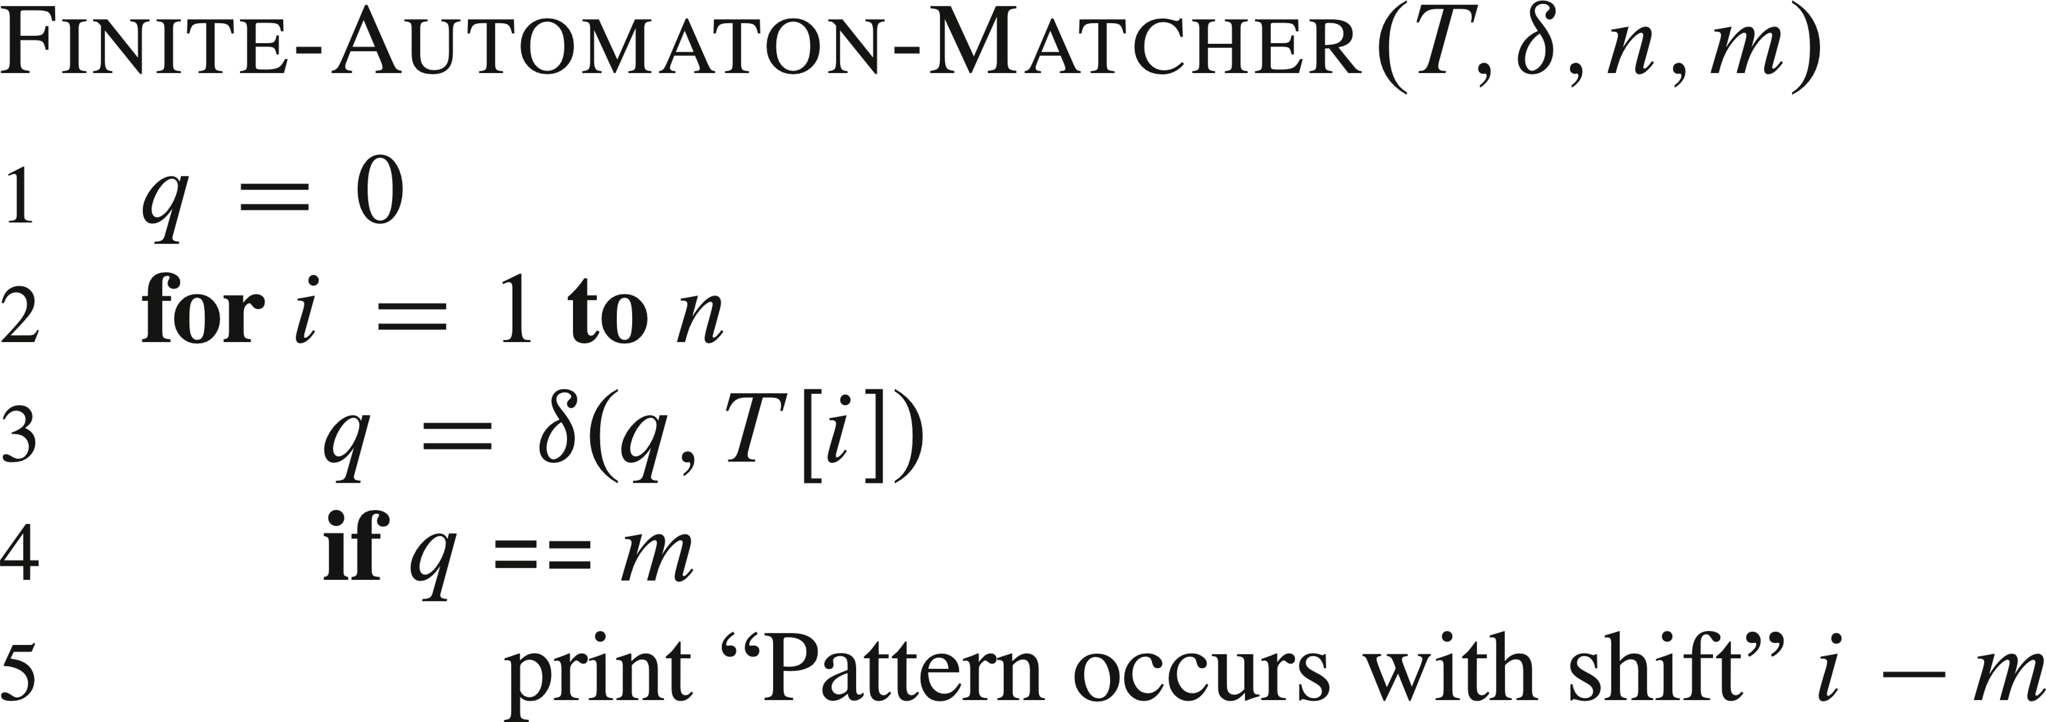
PSEUDOCODE

Slide 16
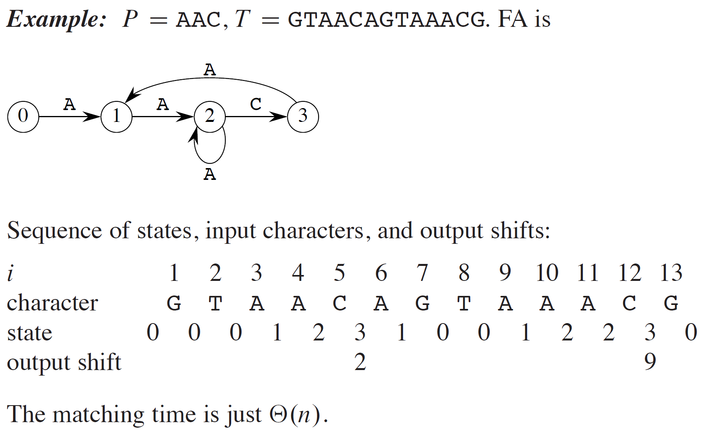
EXAMPLE

Slide 17
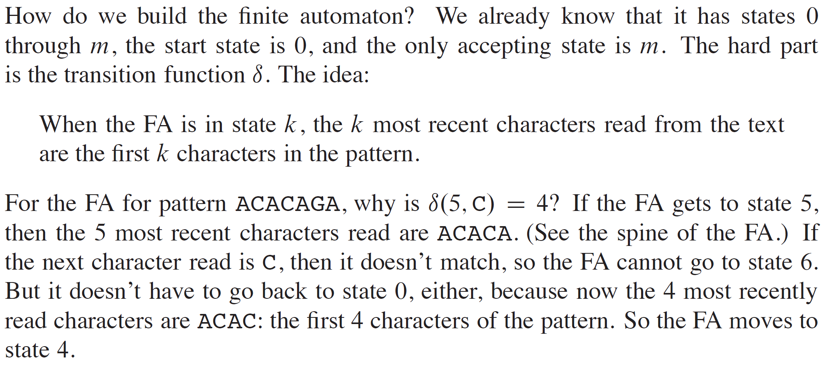
EXAMPLE (continued)

Slide 18
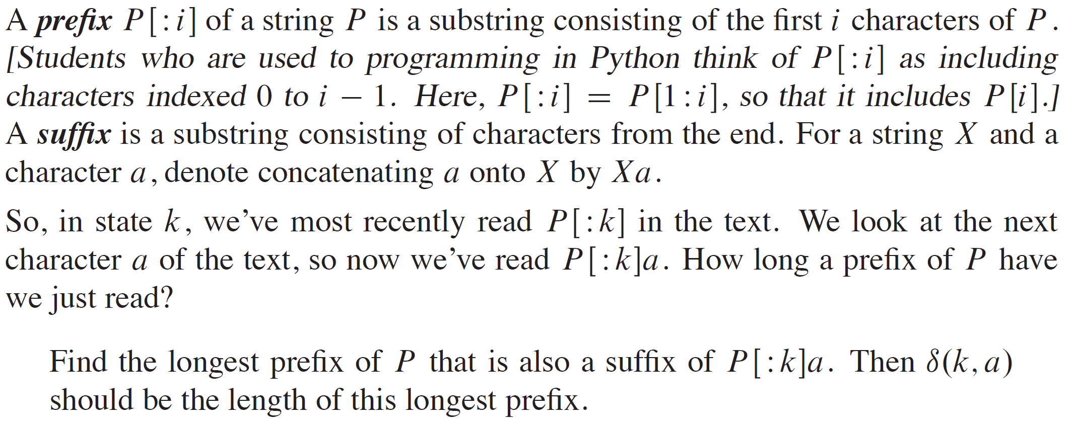
EXAMPLE (continued)

Slide 19
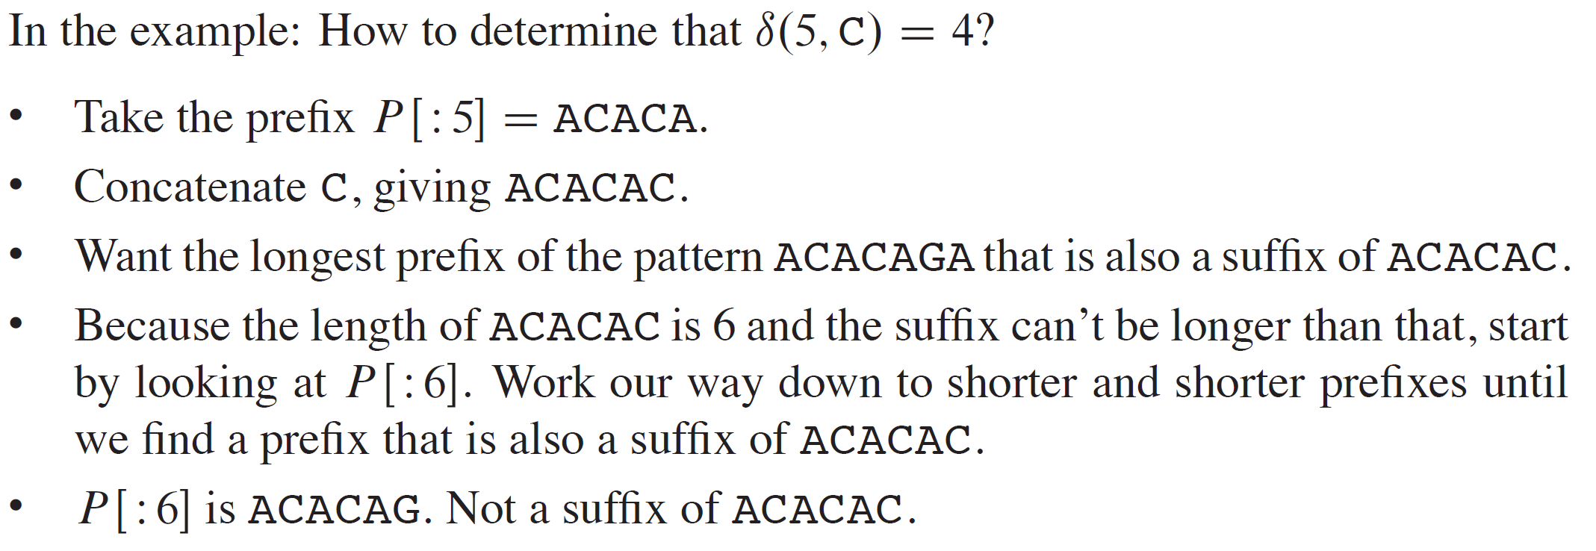
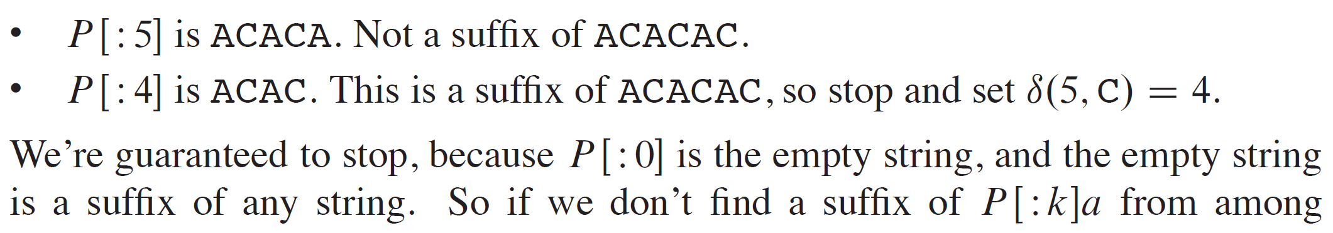
EXAMPLE (continued)

Slide 20
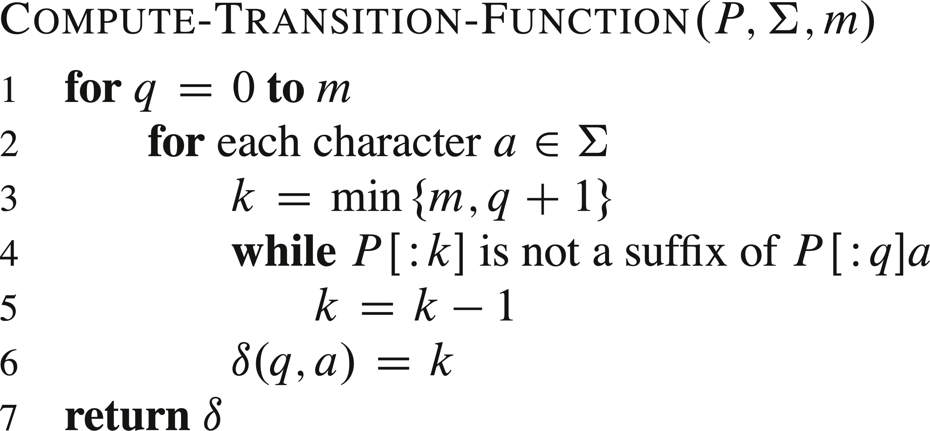
PSEUDOCODE

Slide 21
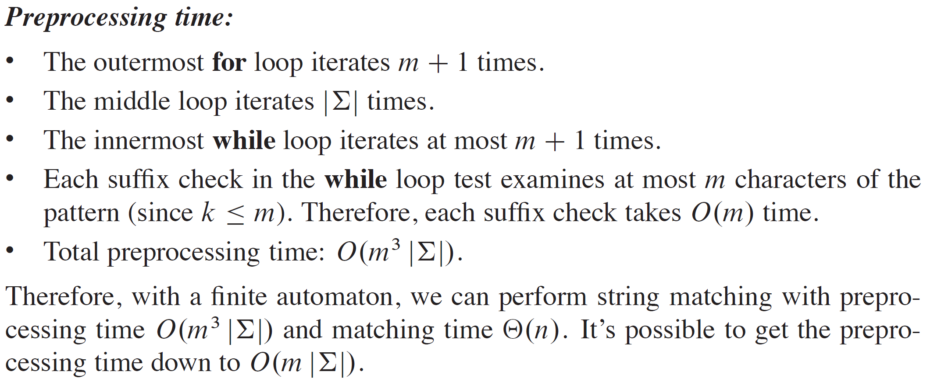
ANALYSIS

Slide 22
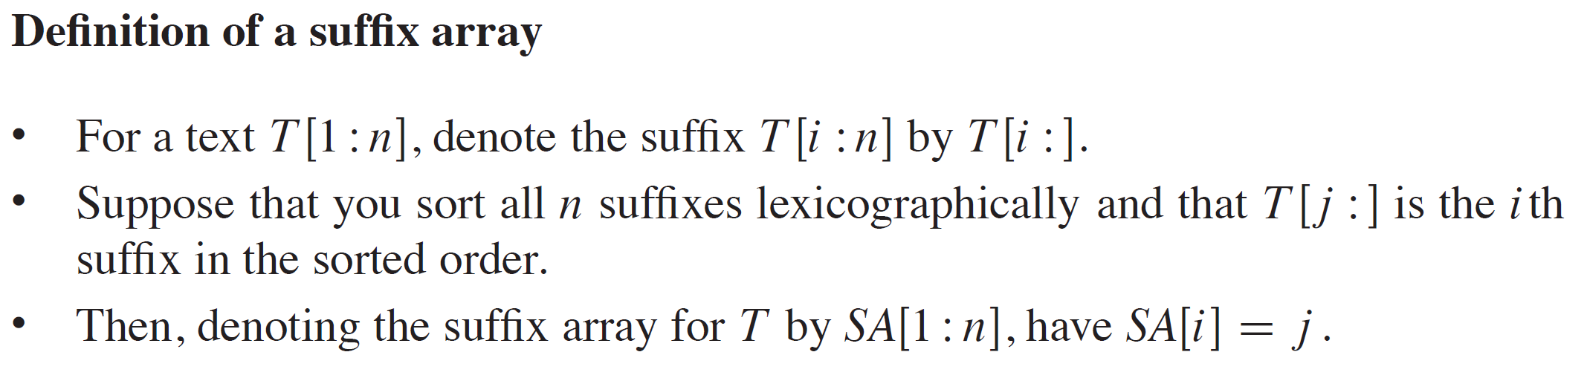
SUFFIX ARRAYS

Slide 23
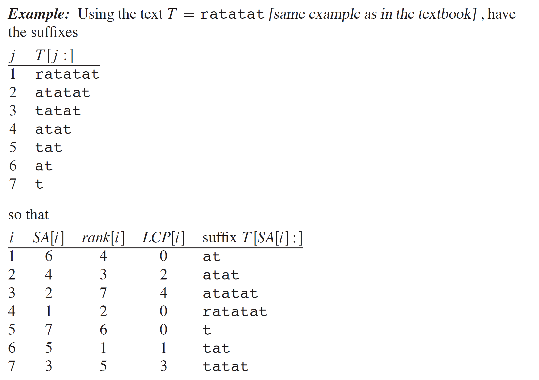
EXAMPLE

Slide 24
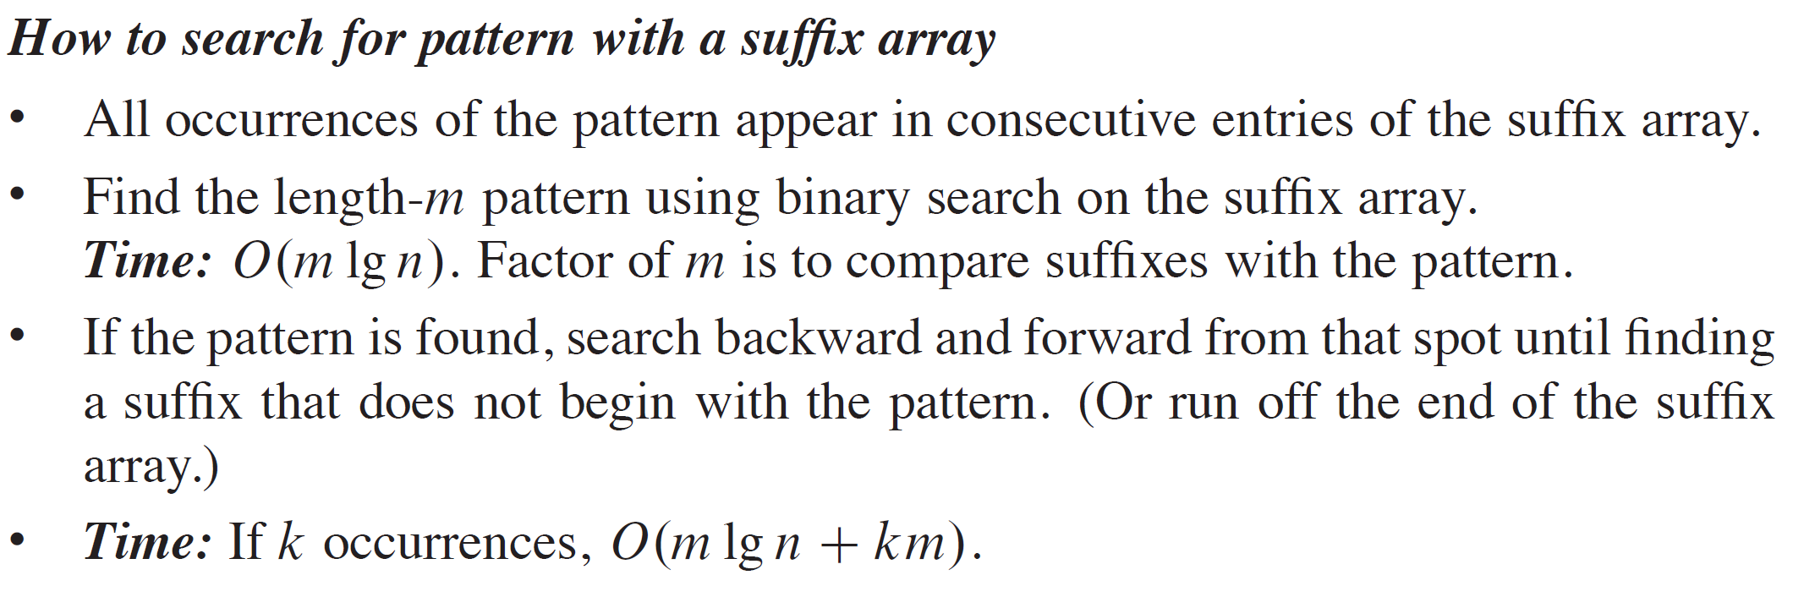
EXAMPLE (continued)

Slide 25
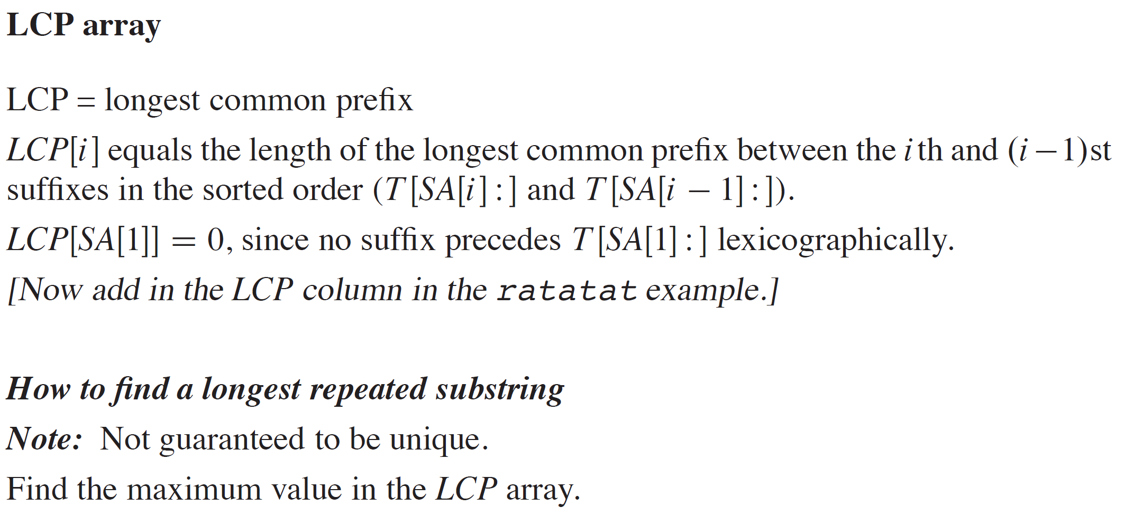
EXAMPLE (continued)

Slide 26
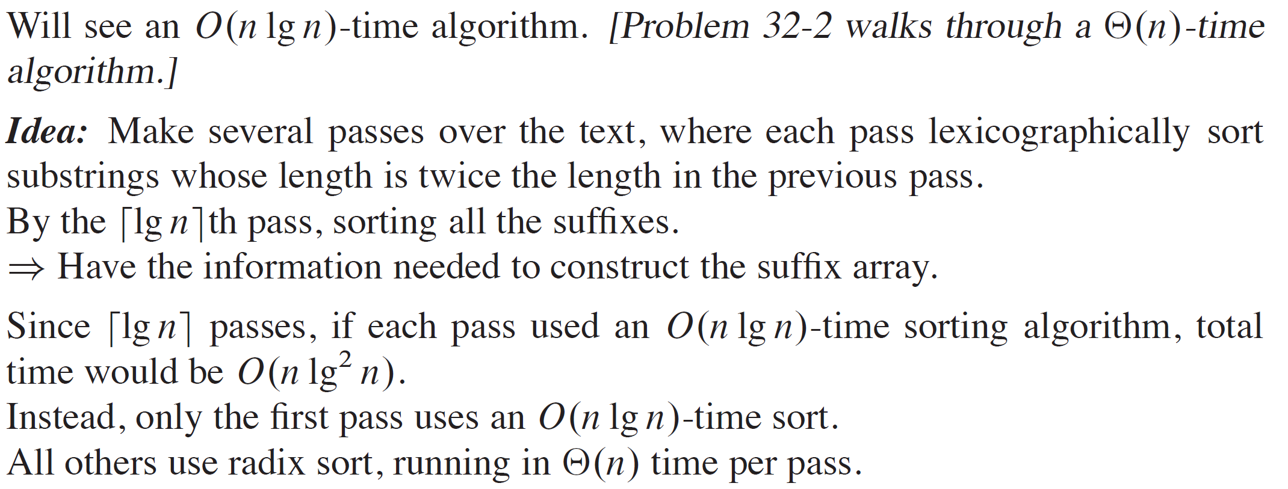
COMPUTING THE SUFFIX ARRAY

Slide 27
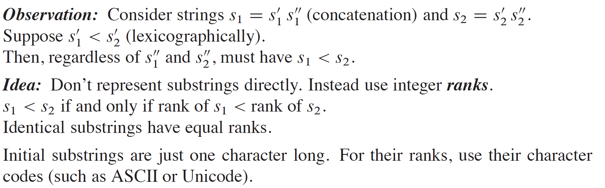
COMPUTING THE SUFFIX ARRAY (continued)

Slide 28
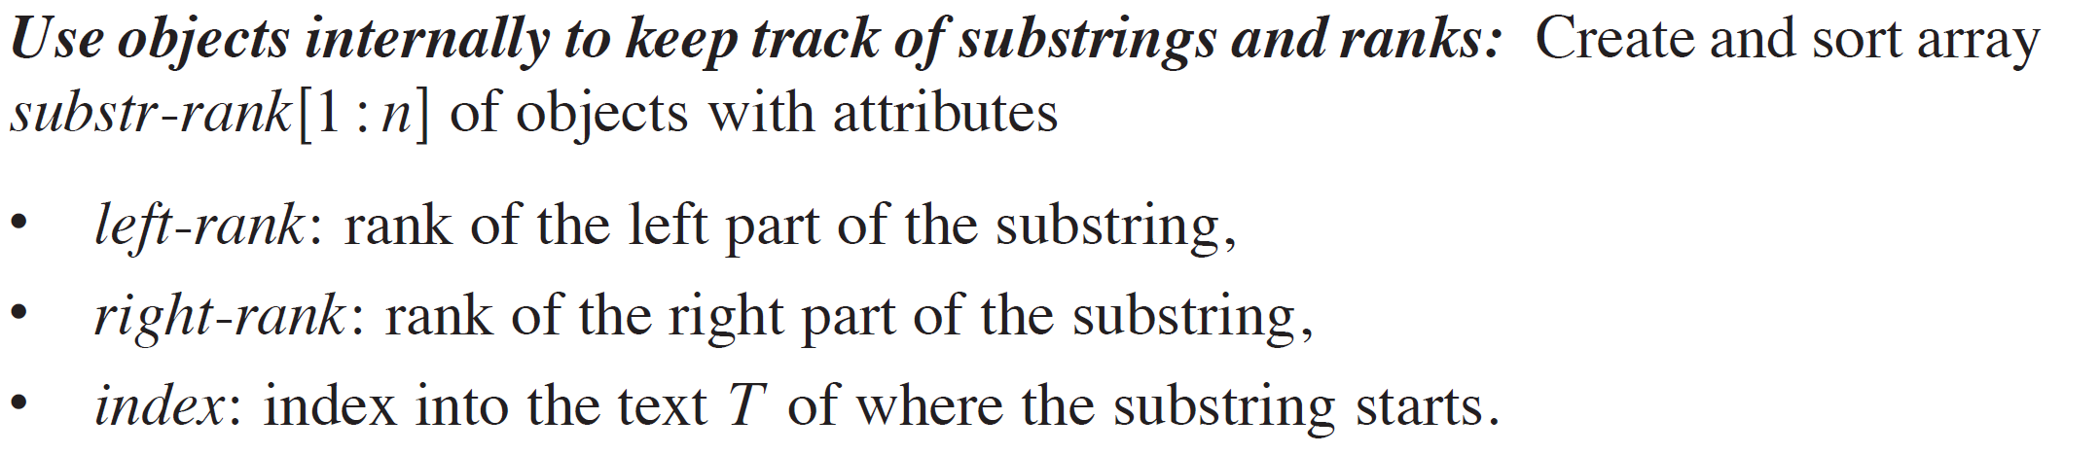
COMPUTING THE SUFFIX ARRAY (continued)

Slide 29
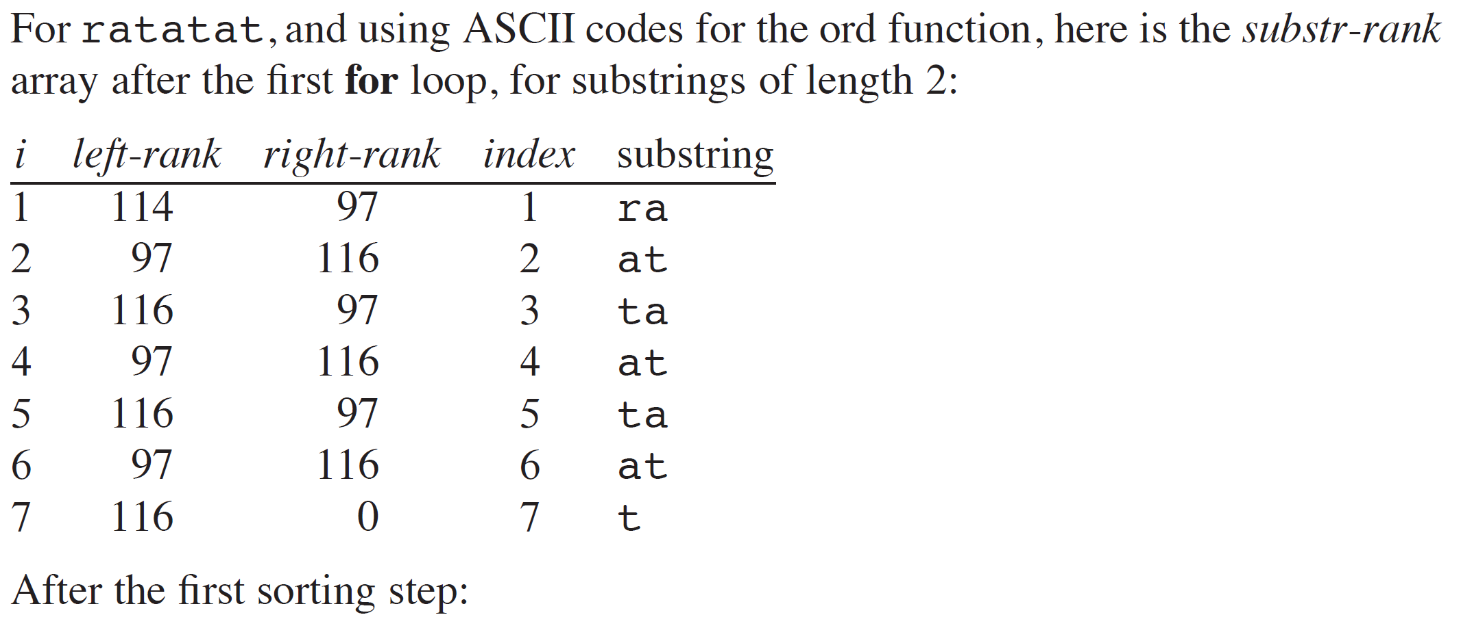
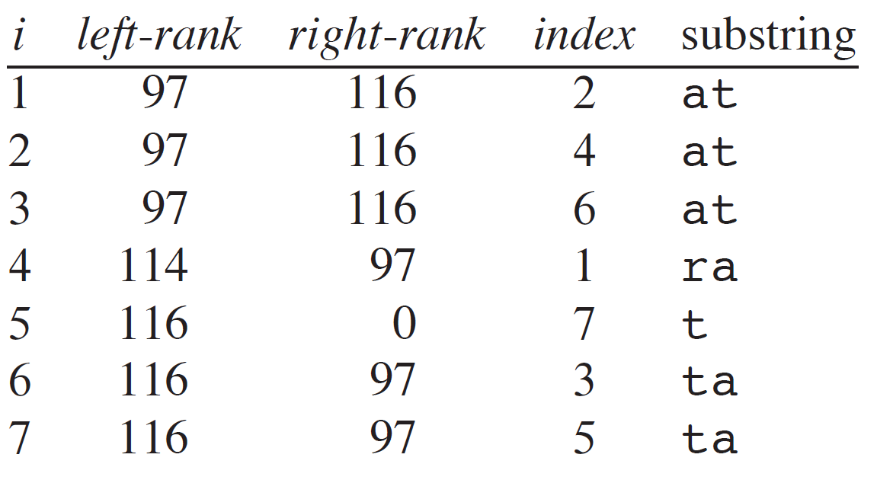
COMPUTING THE SUFFIX ARRAY (continued)

Slide 30
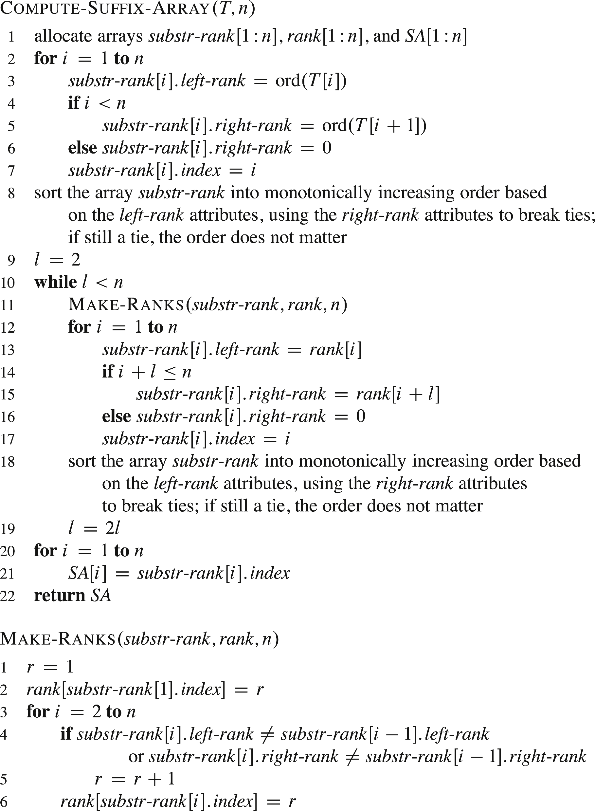
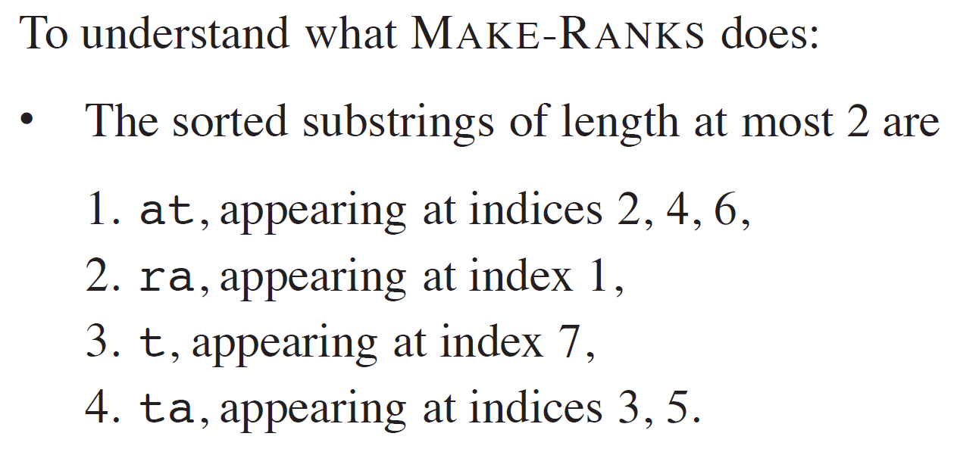
COMPUTING THE SUFFIX ARRAY (continued)

Slide 31
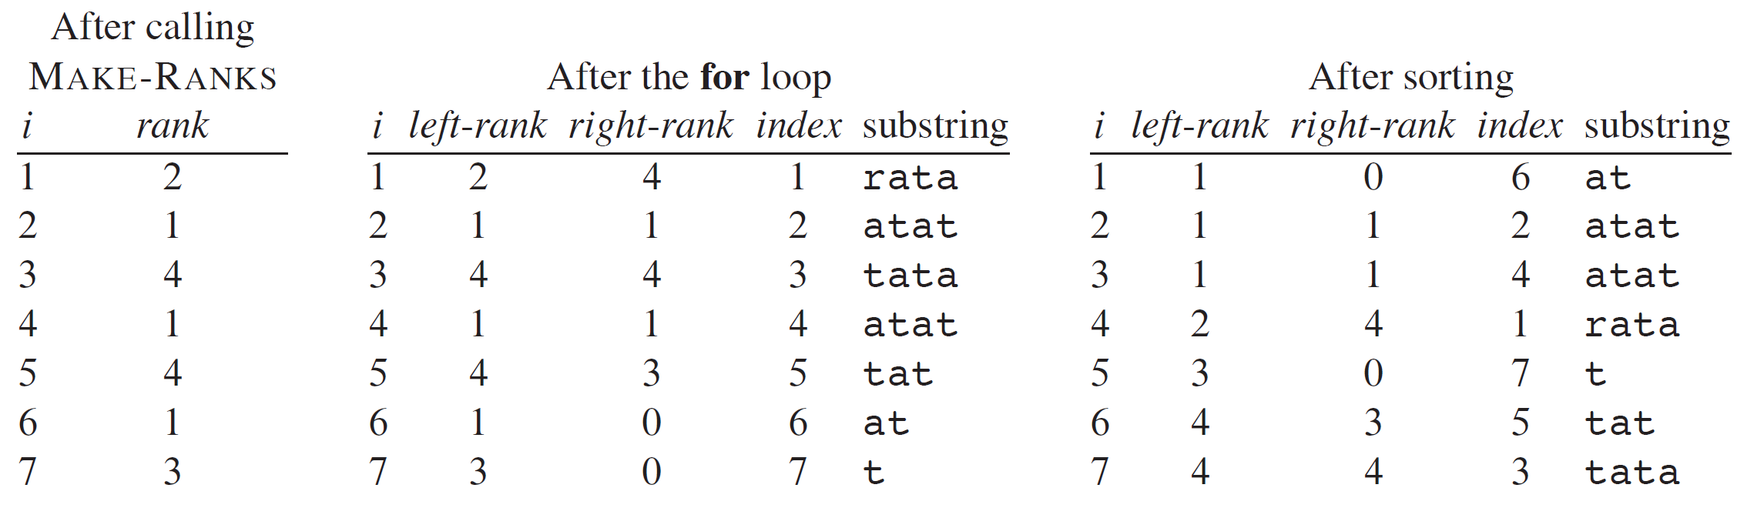
COMPUTING THE SUFFIX ARRAY (continued)

Slide 32
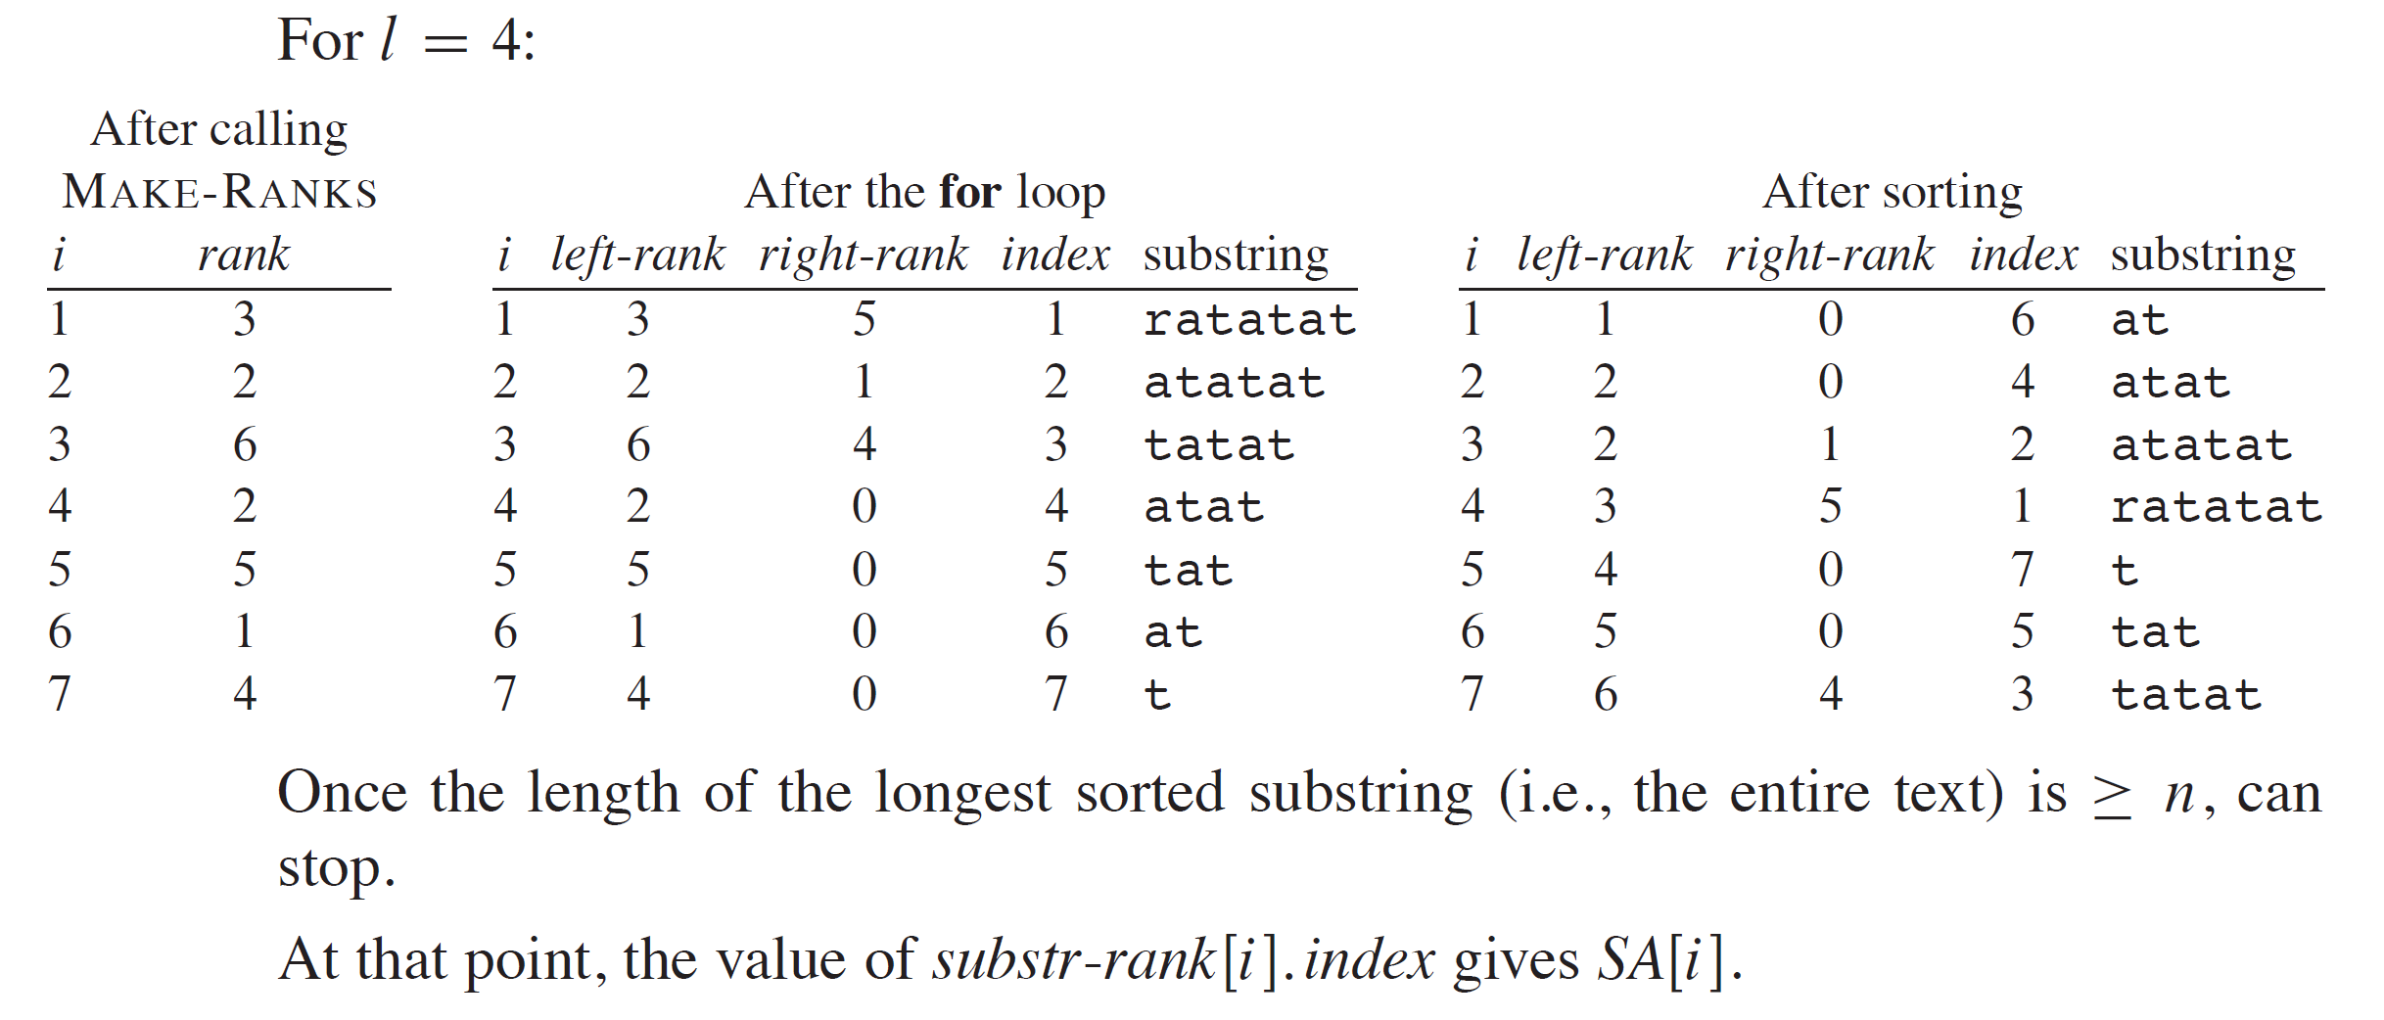
COMPUTING THE SUFFIX ARRAY (continued)

Slide 33
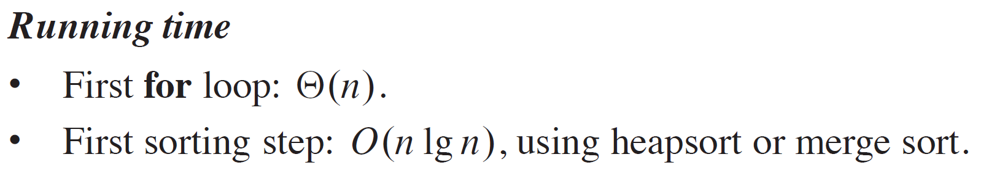
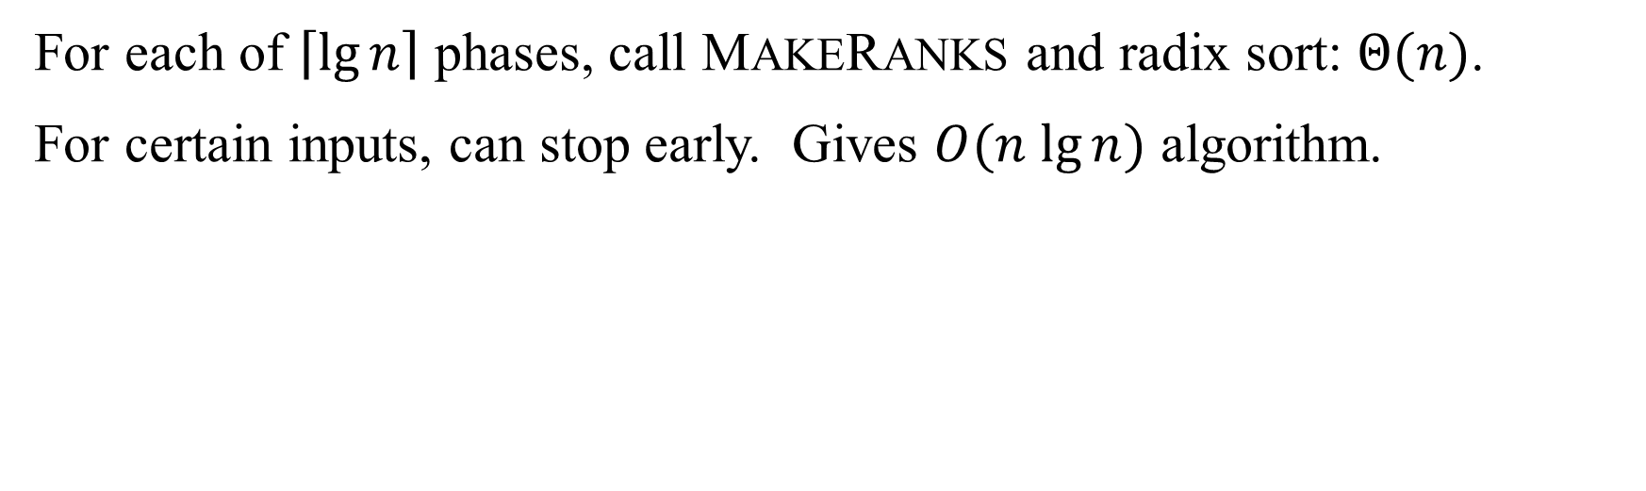
COMPUTING THE SUFFIX ARRAY (continued)
For each of $\left\lceil \lg{n}\right\rceil$ phases, call MAKERANKS and radix sort: $Θ(n)$.
For certain inputs, can stop early. Gives $O(n lg⁡n)$ algorithm.

Slide 34
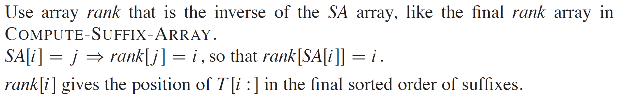
COMPUTING THE LCP ARRAY

Slide 35
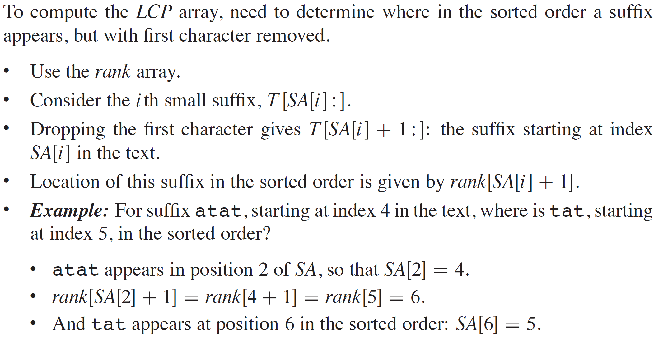
COMPUTING THE LCP ARRAY (continued)

Slide 36
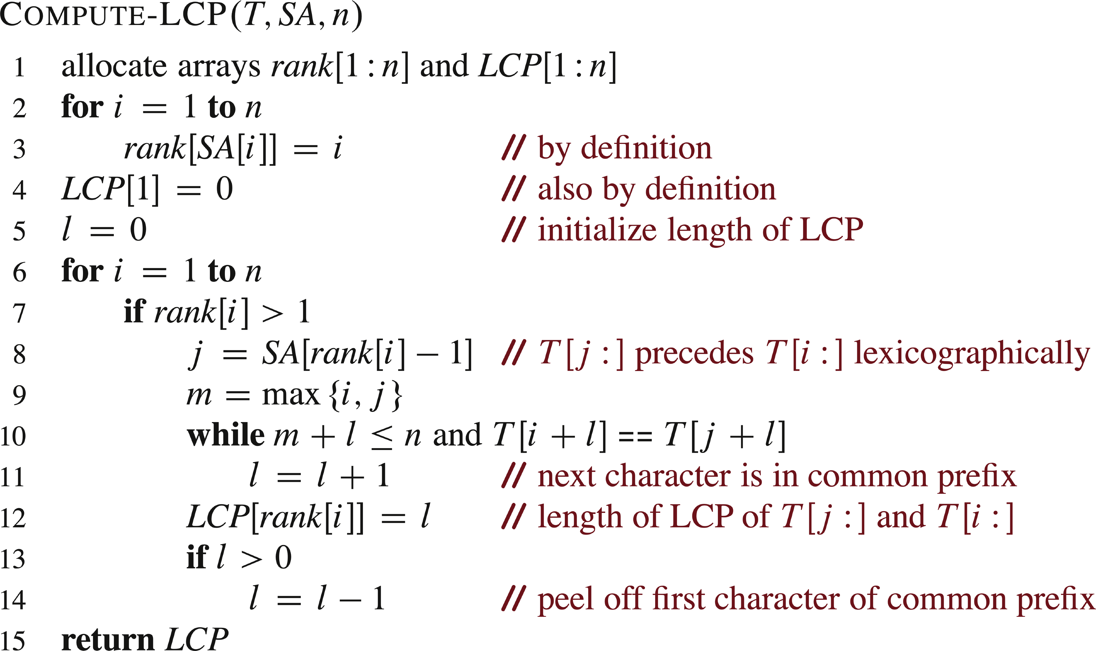
PSEUDOCODE

Slide 37
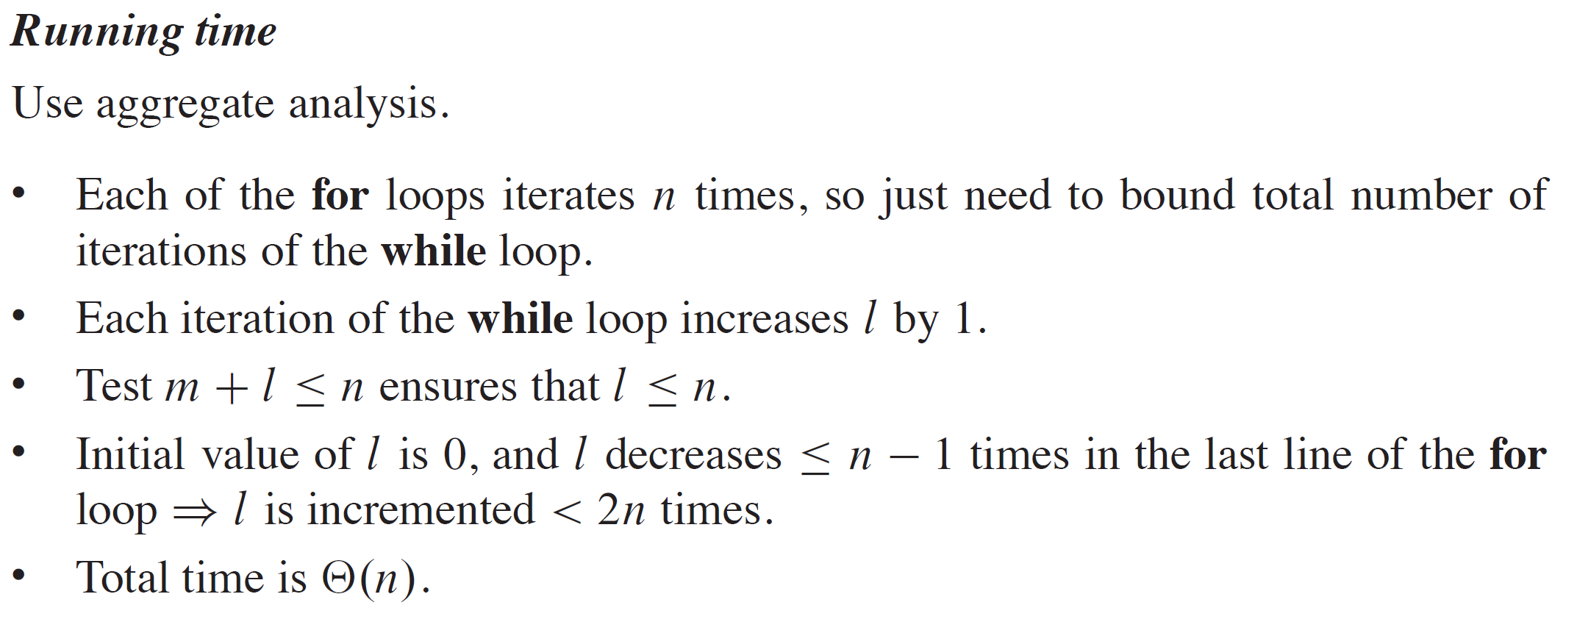
ANALYSIS

